Slide 1
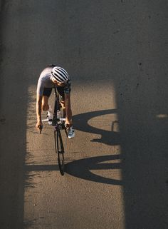
On trying to understand what are the factors that affect and Cycling business.
IN the upcoming slides I’ll explain what are those and why they do have a great effect on these businesses

Slide 2
The factors
Now according to our data we have the following factors that can affect people riding the cycles
Temperature
Weather codes
Specific time zones people ride at.
Some weather factors like humidity and wind
Your company name

Slide 3
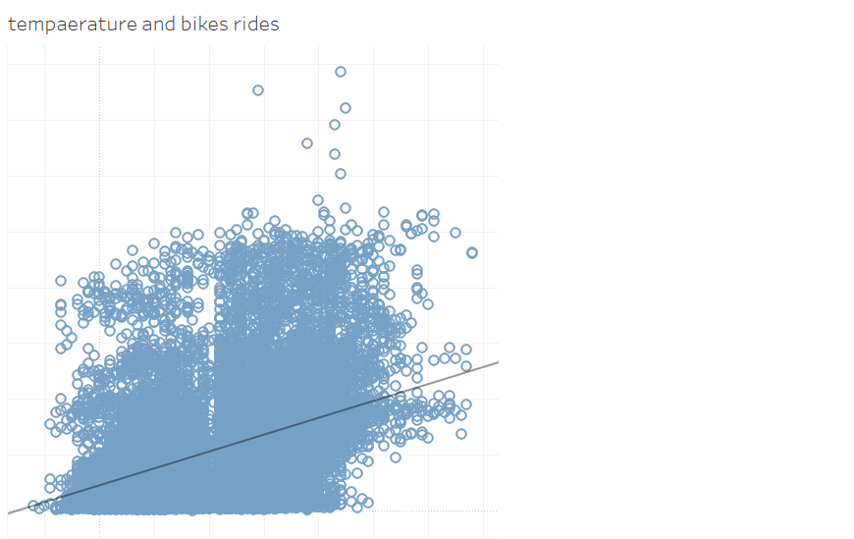
Starting with temperature
Yes, as you may have expected temperature did have an effect on The amount of times they ride.
Let me explain why :
Performance: When the temperature is cooler, air resistance is lower. This means that cyclists can go faster and farther with less effort. In contrast, when the temperature is hot, air resistance is higher. This means that cyclists have to work harder to go the same distance, which can make them less likely to ride as often.
Availability: In cold weather, roads and paths may be icy or snowy, making it unsafe to ride a bike. In contrast, in warm weather, roads and paths are usually clear and safe to ride on. This makes it more convenient to ride a bike, and people are more likely to do it more often.
Seasonality: In many parts of the world, people are more likely to ride their bikes in the summer than in the winter. This is because the weather is usually warmer and sunnier in the summer, which makes it more enjoyable to be outside.

Slide 4
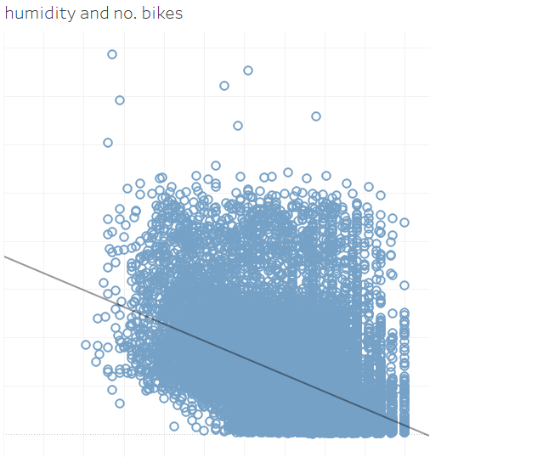
Now Trying to figure out the weather factors, let’s start with humidity
Humidity had a clear negative impact in the way cyclists get to cycle, where the number of cycles used decreased by increasing humidity . Here’s why:
Makes it difficult to cool down: When the air is humid, sweat does not evaporate as easily, which can lead to overheating. This can make riding uncomfortable and even dangerous, and it can discourage people from riding their bikes.
Makes roads and paths more slippery: Humidity can also make the roads and paths more slippery, which can increase the risk of accidents. This is especially true if the roads are wet, as the water can mix with the humidity in the air to create a layer of condensation. This can make it difficult for cyclists to maintain control of their bikes, and it can increase the risk of falling.
Makes it difficult to breathe: When the air is humid, it can be harder to breathe. This is because the water vapor in the air can interfere with the body's ability to absorb oxygen.
Your company name

Slide 5
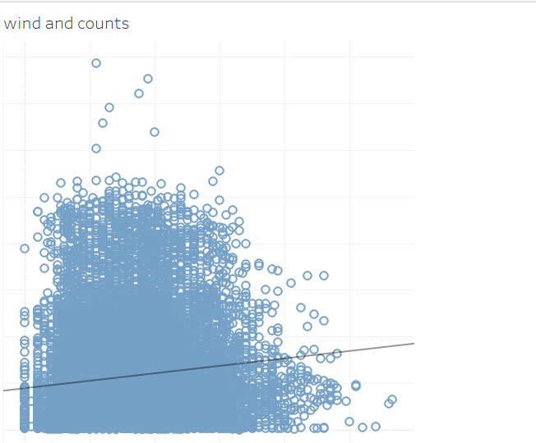

Now that we know what temperature and humidity can do to the rides count
there is a small increase in the number of bike rides as the wind speed increases.
However, the correlation is not strong, so it is possible that other factors, such as temperature or humidity, are also playing a role.
One possibility is that people are more likely to ride their bikes when the wind is blowing because it helps to propel them forward. This can be especially helpful on days when the weather is hot or humid, as it can make riding more comfortable.
Your company name

Slide 6
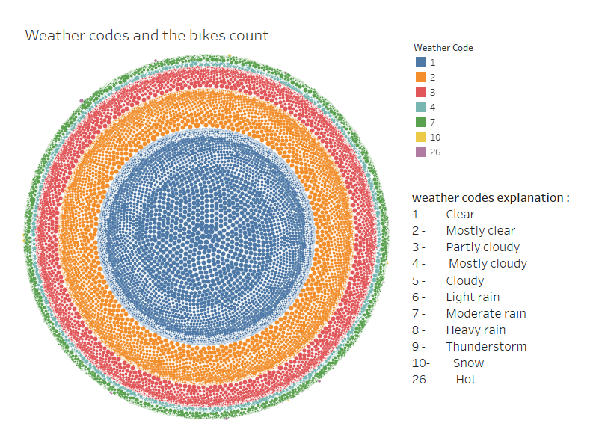
Now discussing what how some weather codes can affect number of cycles rides.
It seems pretty straight forward that the more clear the weather is the more likely it is for people to ride more bicycles.
Your company name

Slide 7
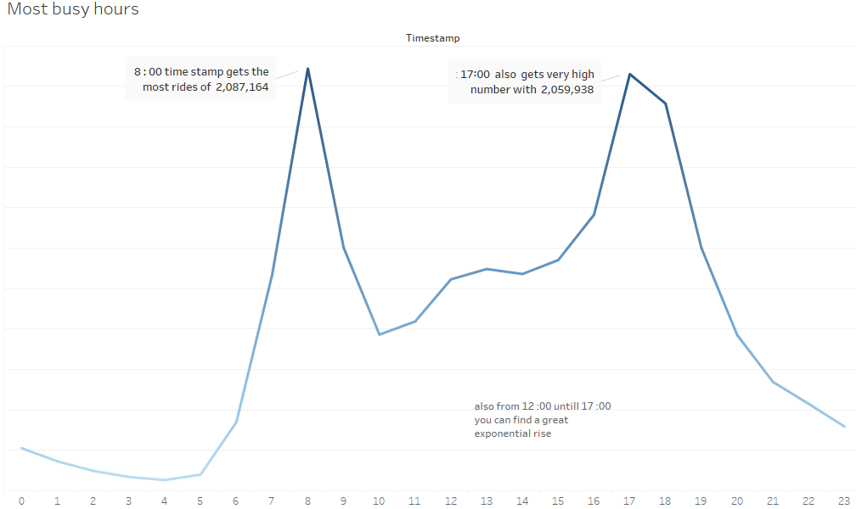
Now when trying to check if there’s any specific hours that are the busiest, here’s what I found :
Your company name

Slide 8
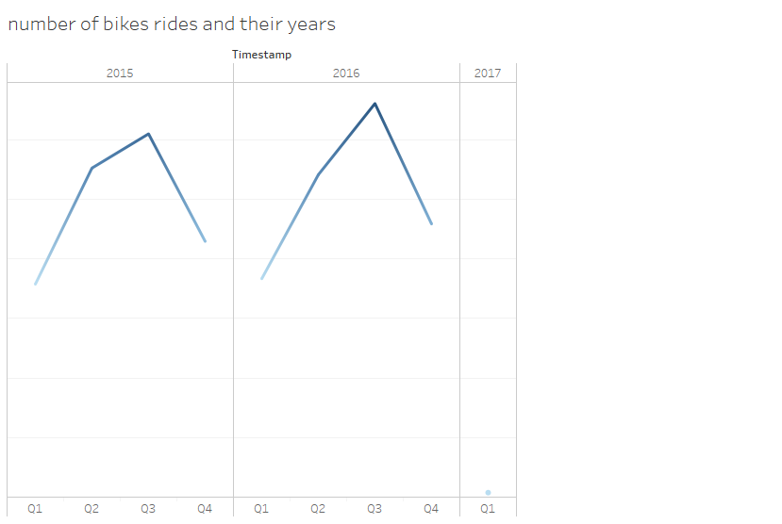

Speaking about timestamps, Here’s my final analysis of quarters in the year where bikes are used the most:
From Quarter 1 until quarter 3 is the busiest time in the year , where from the 3rd quarter until the 4th one the line begins to be negative regarding No. of bikes that are driven
Your company name

Slide 9
Here’s My recommendations to making better decisions when launching a new bicycle event for any biking organizations or the uprising ones
Offer discounts or promotions during humid days. This can encourage people to ride their bikes even when the weather is not ideal.
Offer bike towels and cooling fans during the busiest times between 8:00, 12:00 to 17:00 . This can help to make riding more comfortable on humid days. Bike towels are designed to absorb sweat and keep cyclists cool. You can offer these for rent or purchase at your business.
Offer wind-resistant clothing and accessories. This can make riding more comfortable on windy days.
Promote your business to people who live in areas with clear, mostly clear, or partly cloudy weather. These are the days when people are most likely to ride their bikes.
When hosting events try to make it during peak hours (6:00 to 8:00 AM and 12:00 to 17:00 PM). This can help to accommodate the increased demand for bikes during these times.
Offer bike tours and events during the busiest time of the year (quarter 1 to quarter 3). This can help to attract more customers and boost your business.You can even sell products related to your brand like helmets or locks.

Slide 10
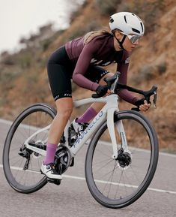
Thank You for your patience and time

